Slide 1
1-1 New Doxology
New Doxology

Slide 2
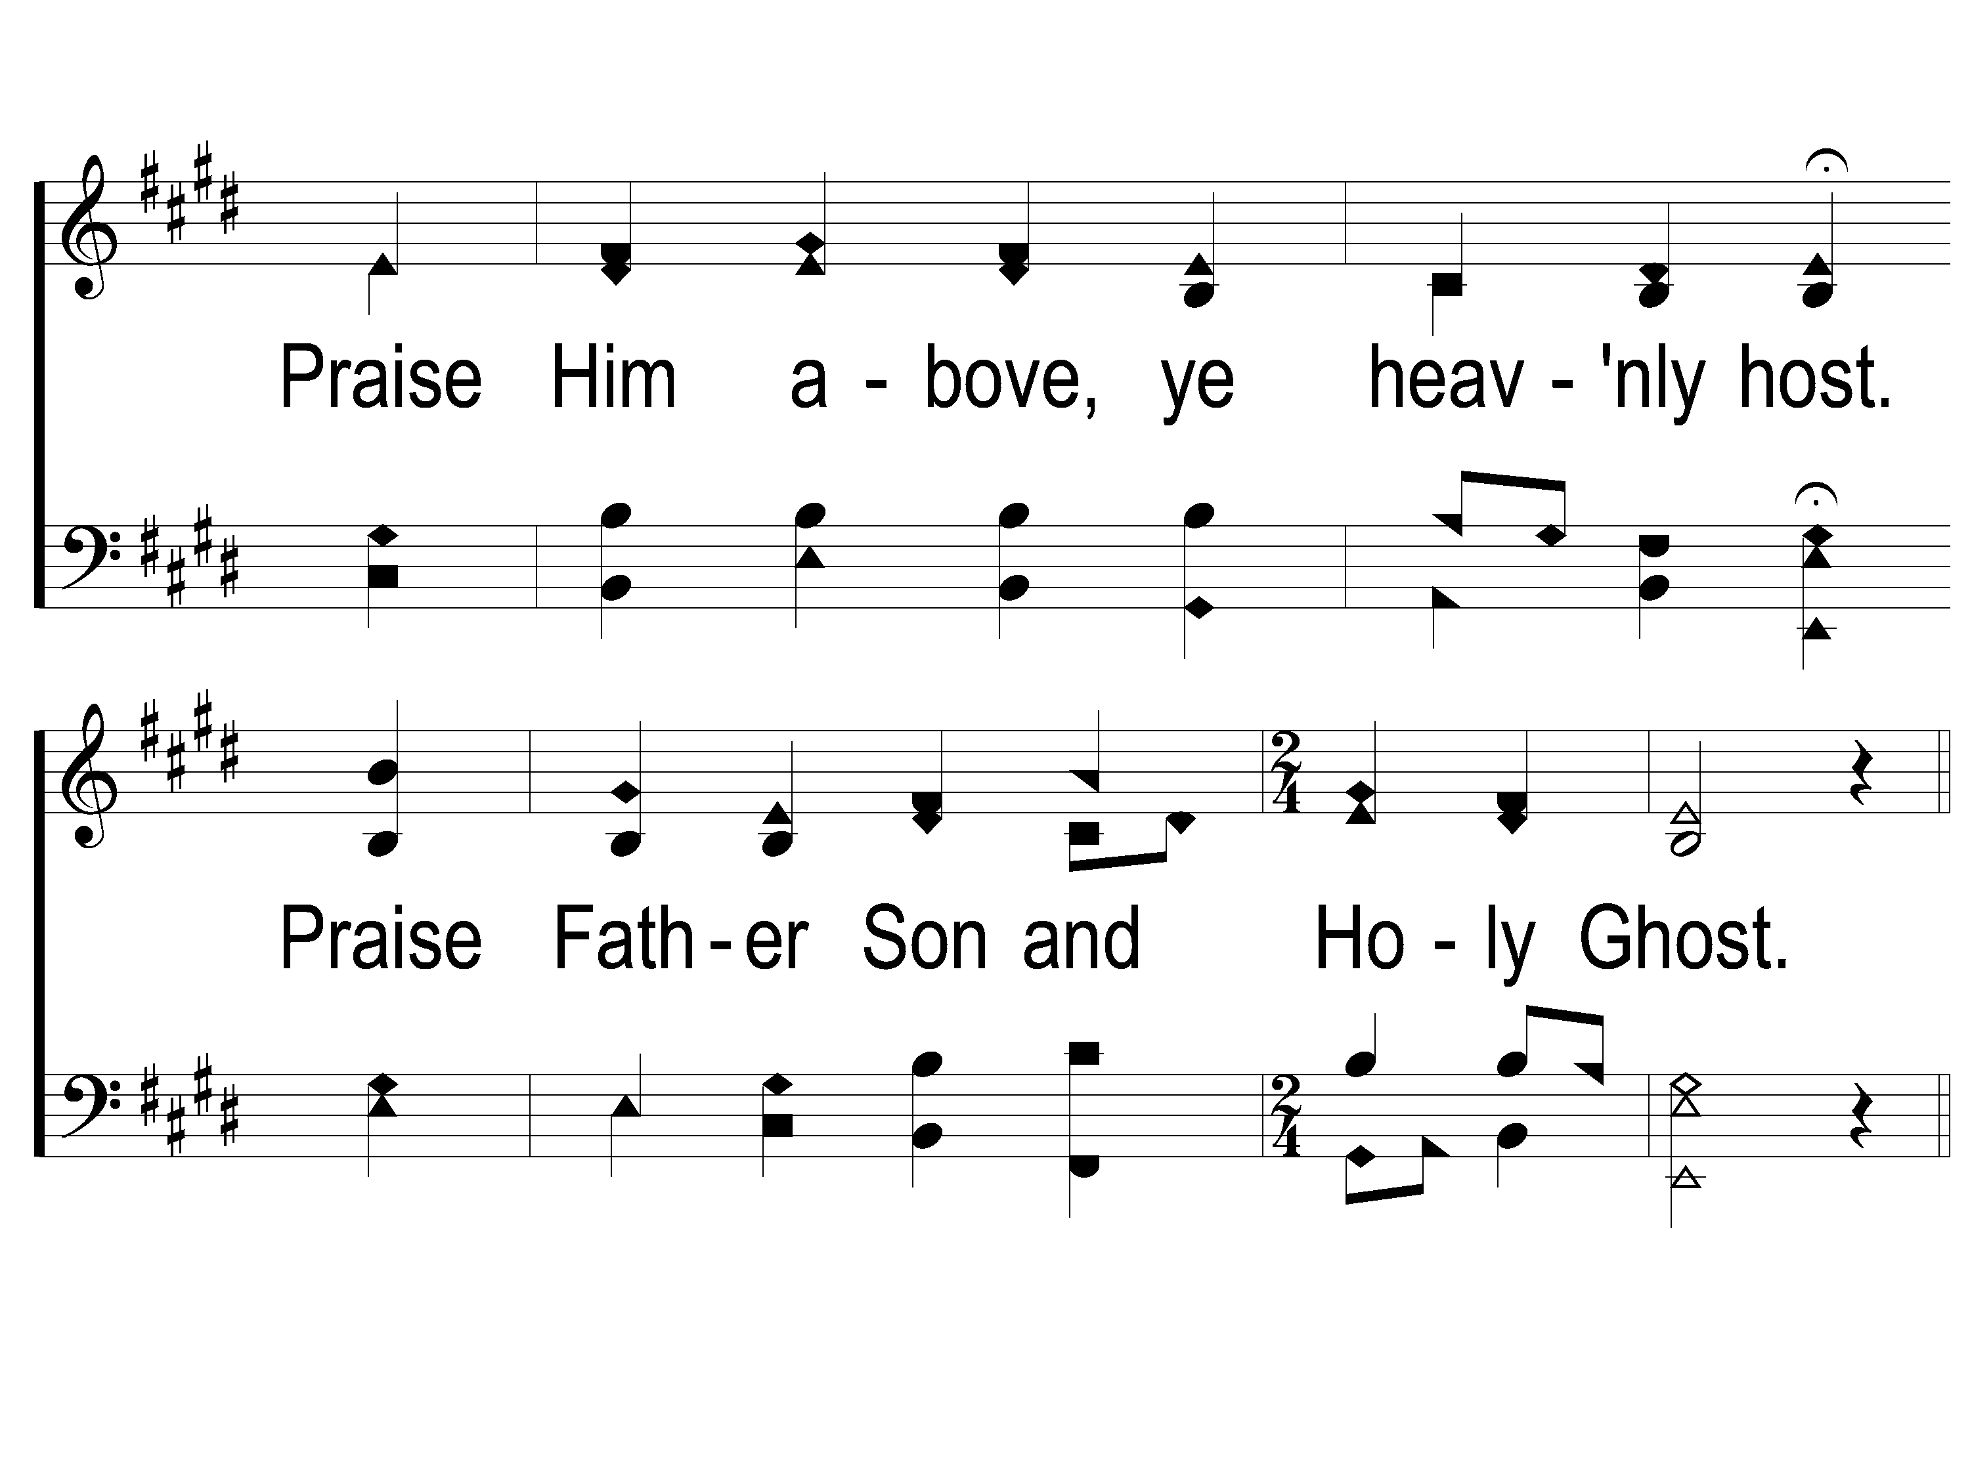
1-2 New Doxology
New Doxology

Slide 3
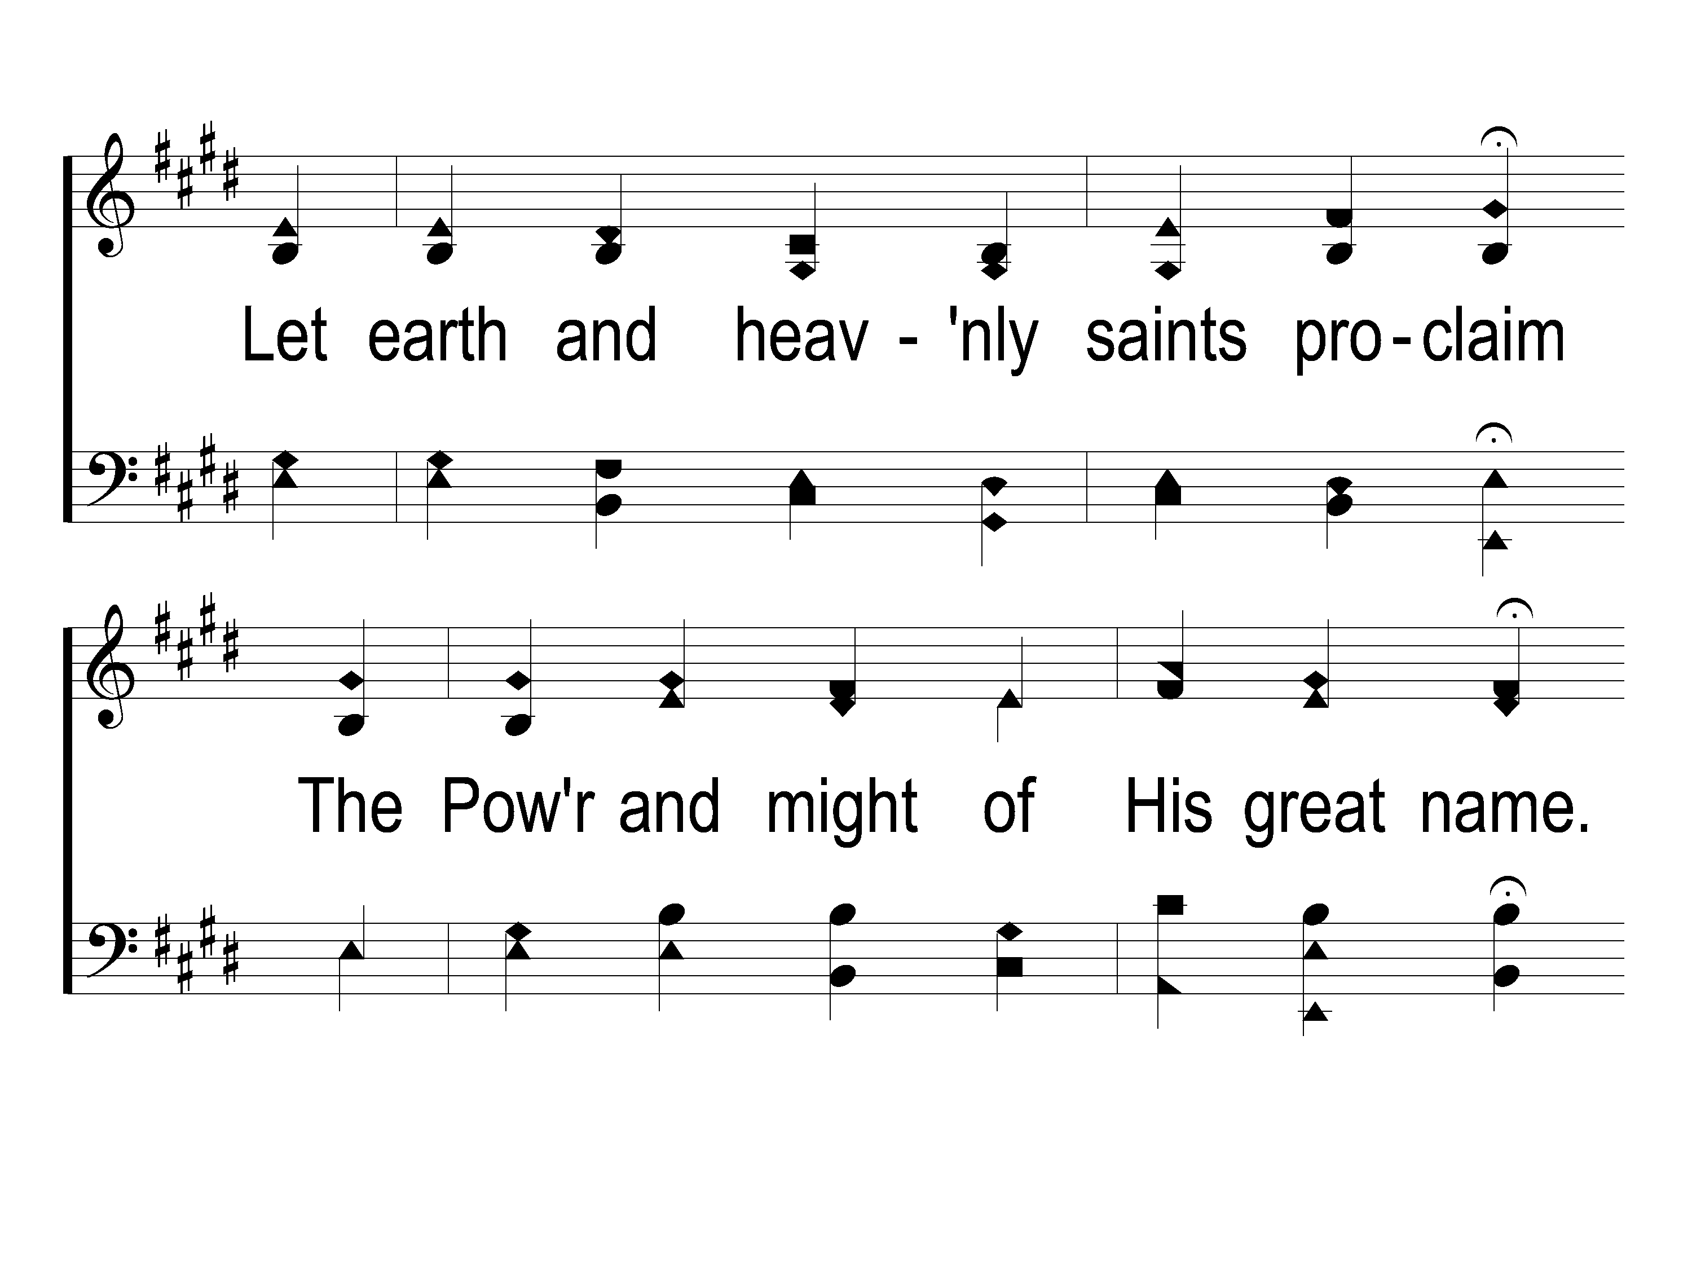
1-3 New Doxology
New Doxology

Slide 4
1-4 New Doxology
New Doxology

Slide 5
C-1 New Doxology
New Doxology

Slide 6
C-2 New Doxology
New Doxology

Slide 7
3-1 New Doxology
New Doxology

Slide 8
3-2 New Doxology
New Doxology

Slide 9
2c-1 New Doxology

Slide 10
2c-2 New Doxology
New Doxology

Slide 11
2c-3 New Doxology
New Doxology

Slide 12
4-1 New Doxology
New Doxology

Slide 13
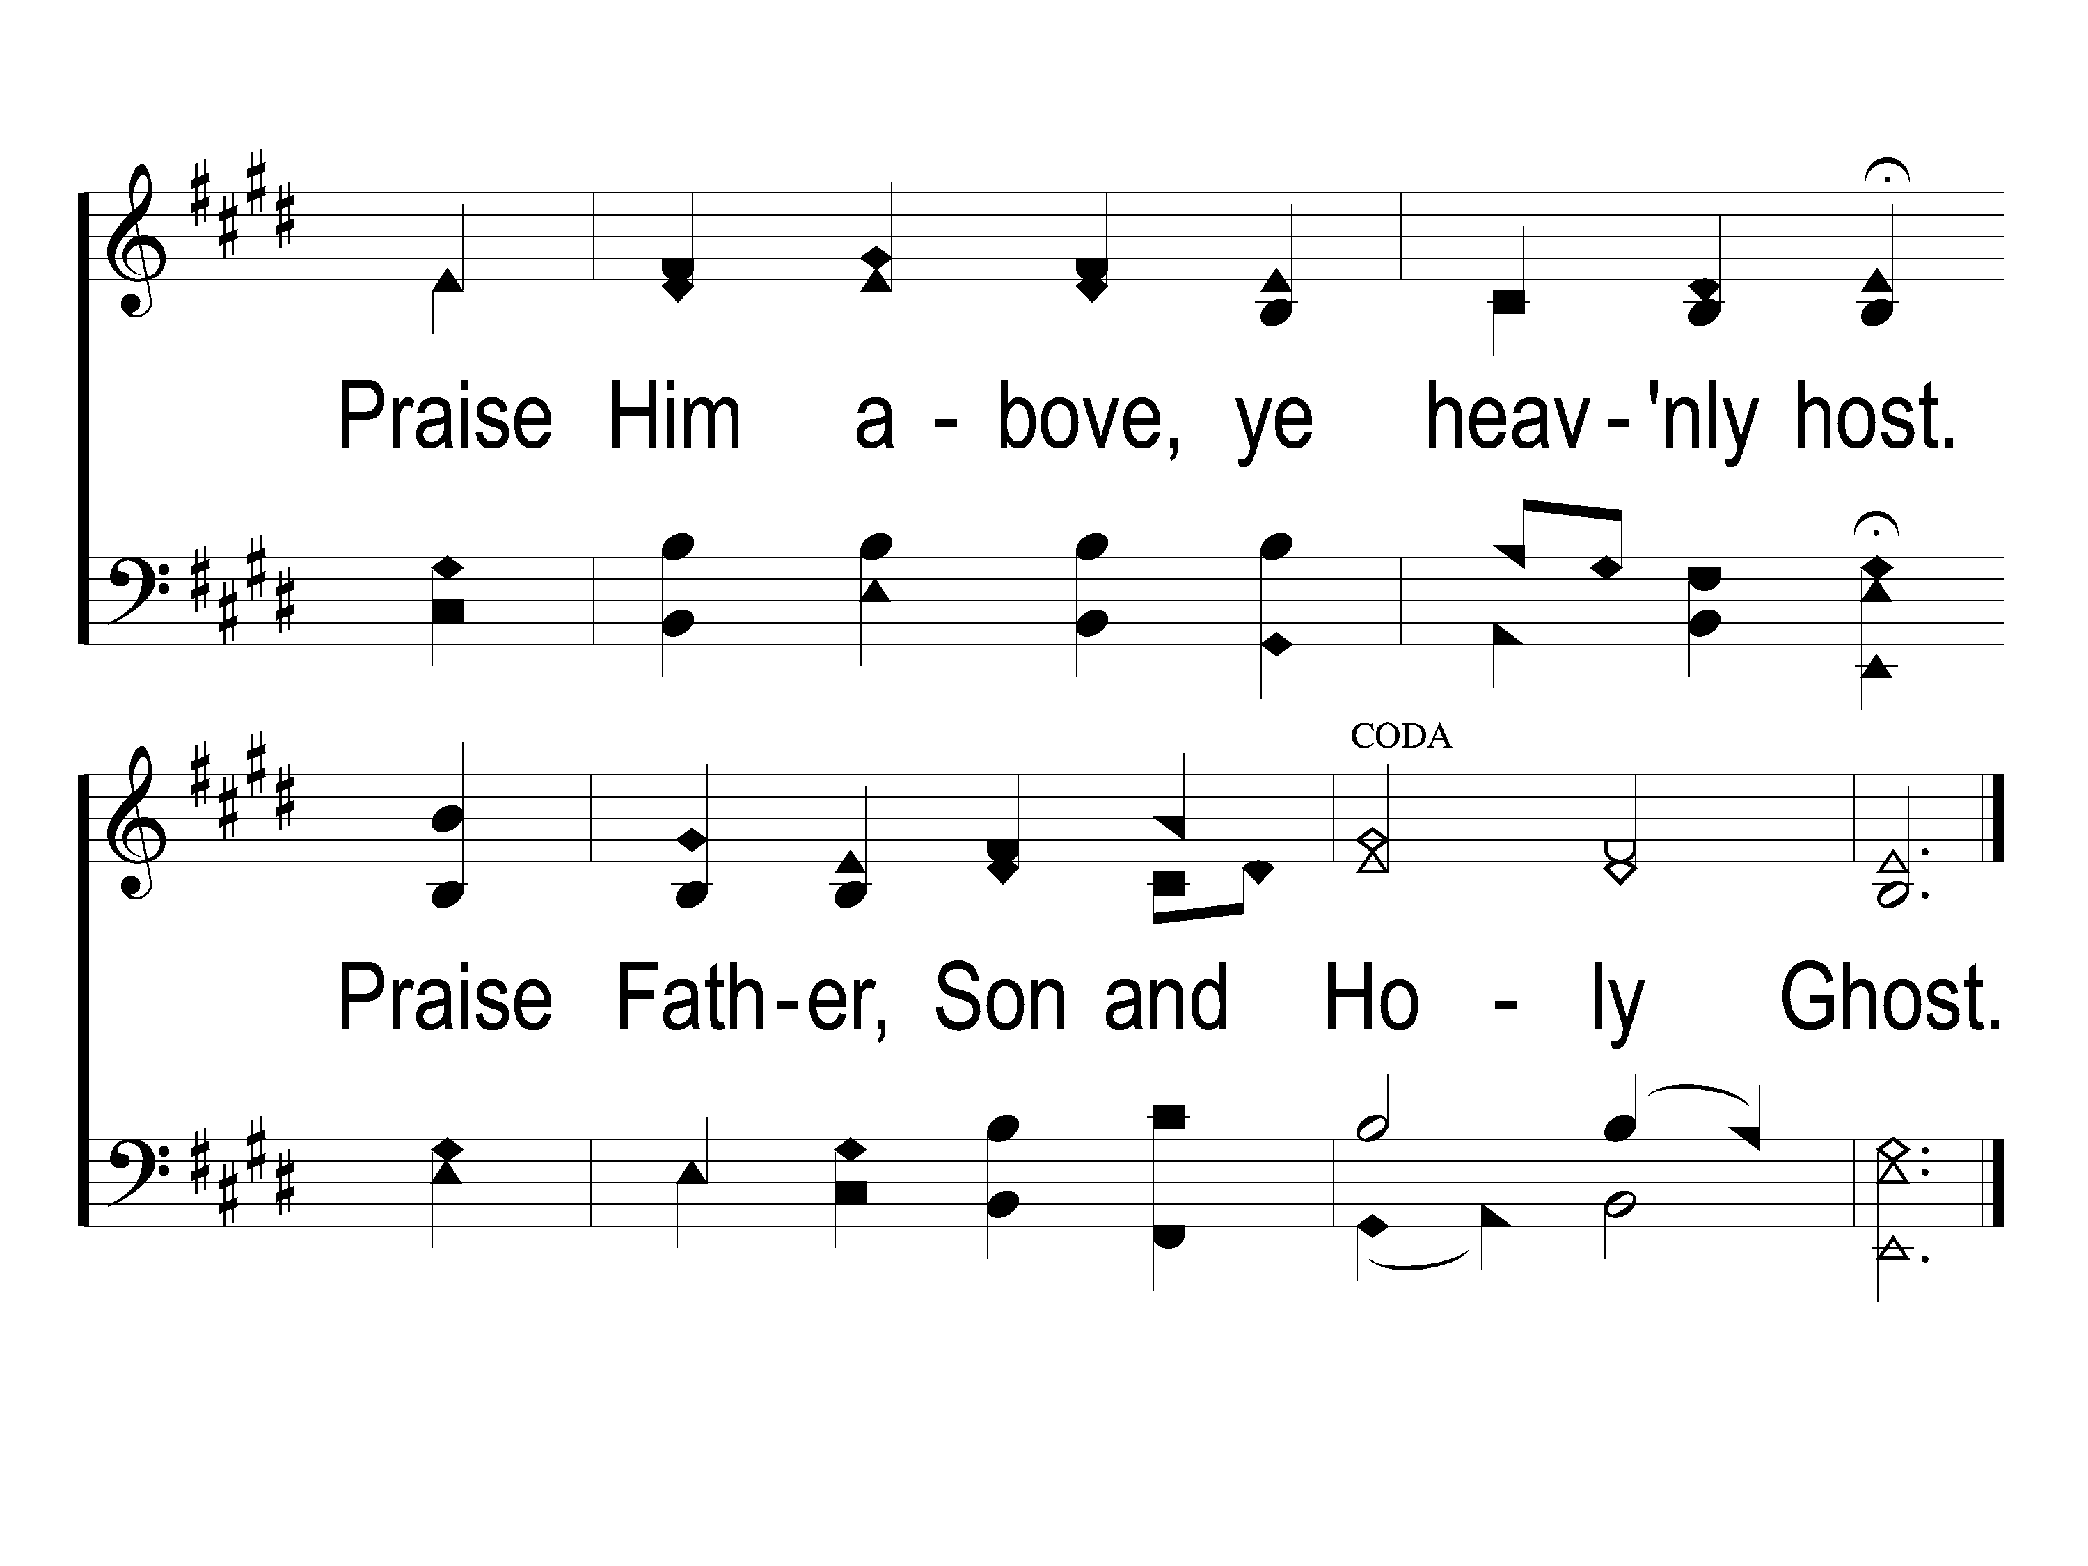
4-2 New Doxology
New Doxology

