Slide 1
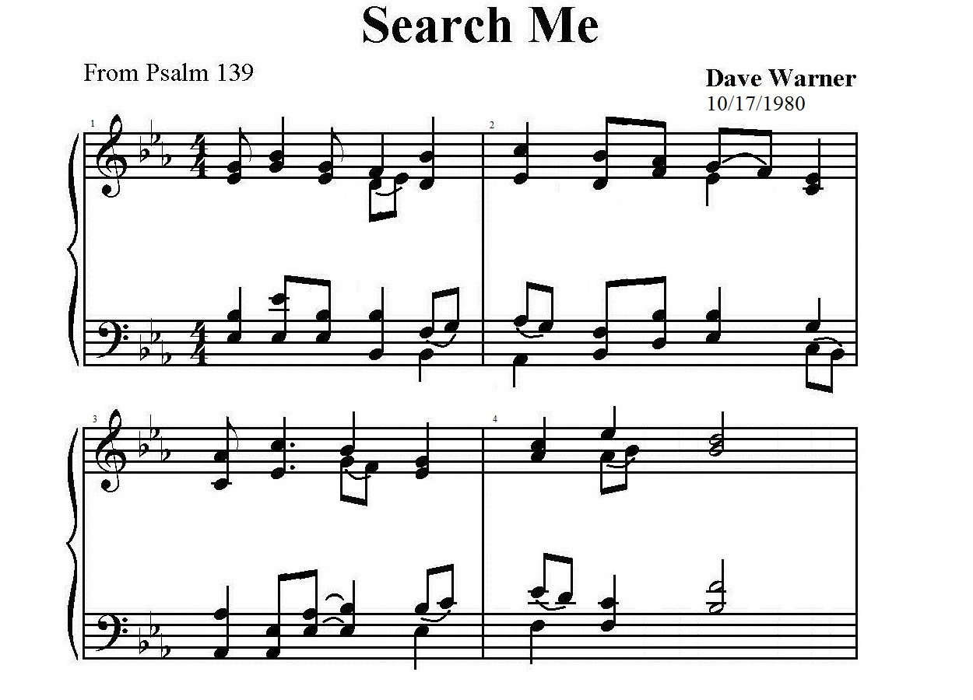
m 1. O Lord, you see me, My Lord you know me.
You know when I sit and rise.

Slide 2
You un – der - stand my soul and my spi - rit
On - ly You are per- fect - ly wise. – Please!

Slide 3
Search me, test me, try ̶ me and know my heart.
Lord, search me, test me, try me and know my heart.
Look deep in - to my anx - ious thoughts.

Slide 4
See if to an - y of - fense ̶ I cling, Lord and
lead me in the way e - ver – las ̶ ting.

Slide 5
p 2. Where can I go to flee from Your Spi - rit?
Your great hand is e - very where;

Slide 6
High in the hea - vens low in the wa - ters
On-ly your hand will guide me there. ̶ Please!

Slide 7
Search me, test me, try ̶ me and know my heart.
Lord, search me, test me, try me and know my heart.
Look deep in - to my anx - ious thoughts.

Slide 8
See if to an - y of-fense ̶ I cling, Lord and
lead me in the way e - ver - las- ̶ ting.

Slide 9
f 3. You knit to – ge – ther all of my be - ing.
I was wo - ven by your hand.

Slide 10
Your works are migh - ty; That I know full well.
On-ly you cre – at - ed each man. ̶ Please!

Slide 11
Search me, test me, try ̶ me and know my heart.
Lord, search me, test me, try me and know my heart.
Look deep in - to my anx - ious thoughts.

Slide 12
See if to an - y of-fense ̶ I cling, Lord and
lead me in the way e - ver – las ̶ ting.

Slide 13
Search me, test me, try ̶ me and know my heart.
Lord, search me, test me, try me and know my heart.
Look deep in - to my anx - ous thoughts.

Slide 14
See if to an - y of-fense ̶ I cling, Lord and
lead me in the way e - ver - las- ̶ ting. Lord and

Slide 15
Cresc.
lead me in the way e -ver - las- ̶ ting!

